Slide 1


EcoTrack
Sustainable Room Energy Monitoring Project
By Ruxandra Burian, Zichen Jing (Nancy), Jiwoo Lee, Afra Alhammadi, Renata Espinosa
by Ruxandra Burian, Zichen Jing (Nancy), Jiwoo Lee, Afra Alhammadi, Renata Espinosa

Slide 2
General Structure
Start → detect humidity, temperature, accelerometer → data logged
Case 1: Window open/close
Humidity increase beyond threshold → data recorded → LED red light & notification to phone
Case 2: Thermostat on/off
Temperature starts to decrease and plateau → data recorded for the duration → LED red light & notification to phone
Case 3: Light on/off
Accelerometer detects movement in switch (switch 1 and 2) → data recorded for the duration → LED red light & notification to phone

Slide 3
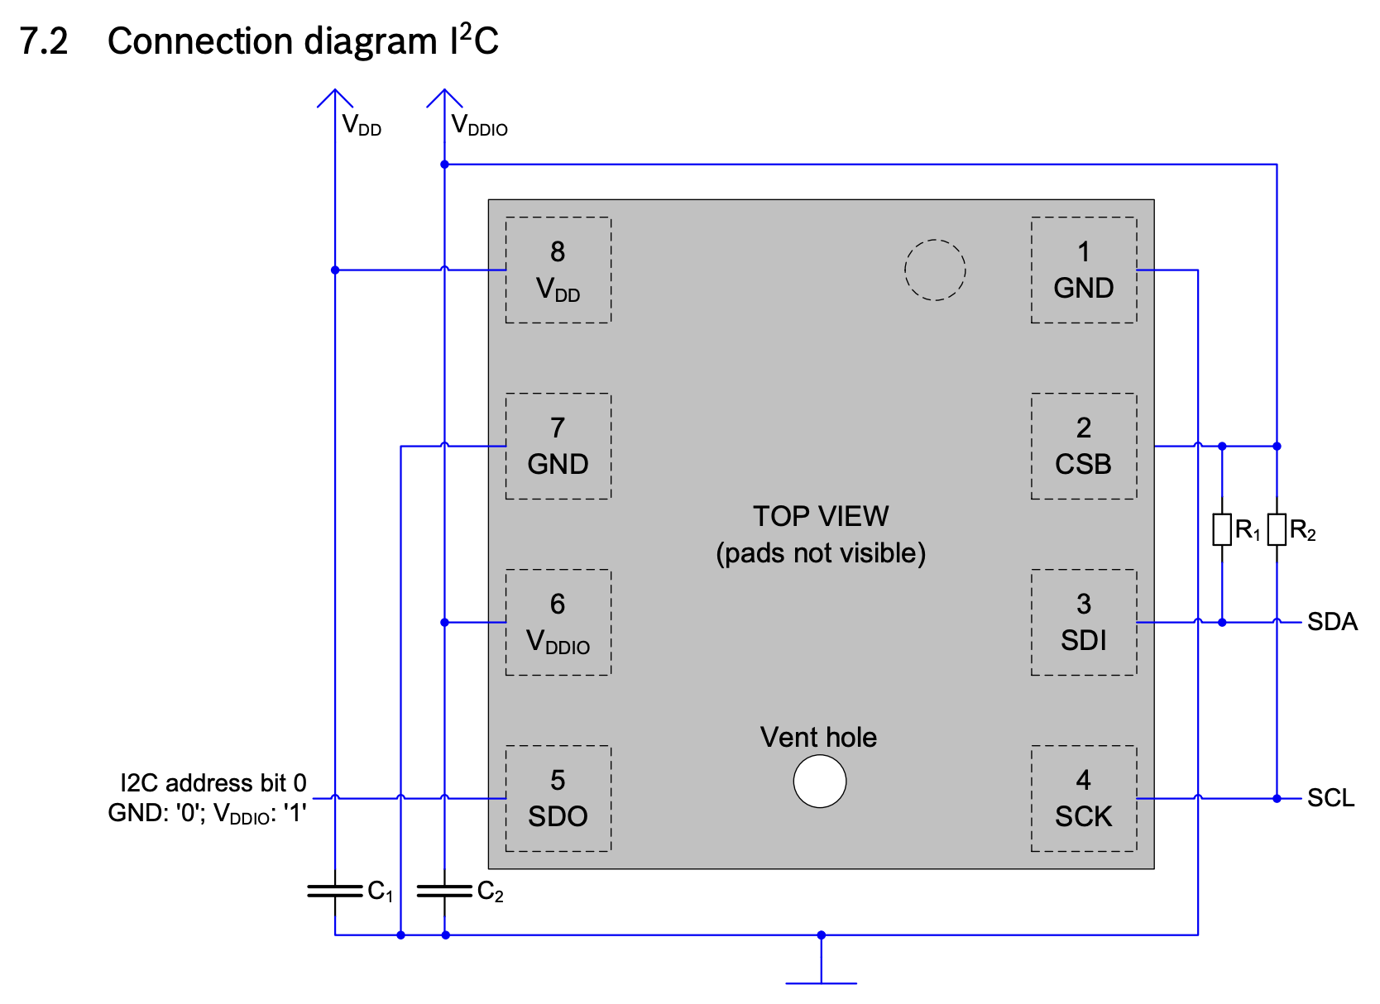
Datasheets used for circuit design
BME280

Slide 4
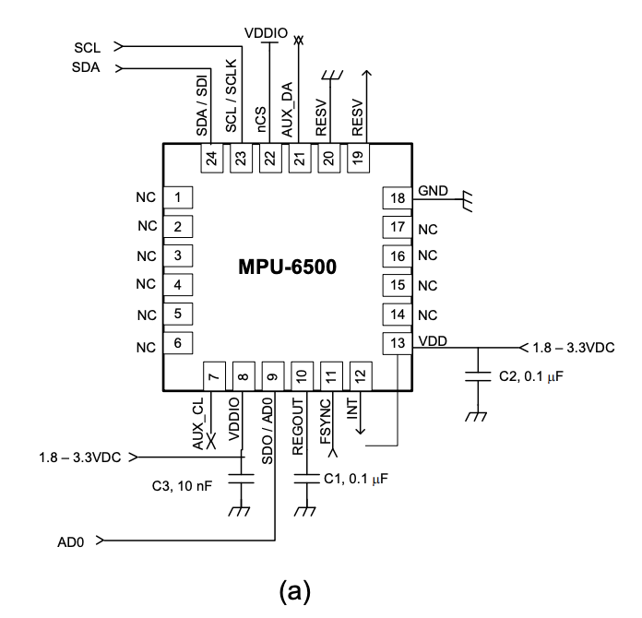
Datasheets used for circuit design
MPU-6500

Slide 5
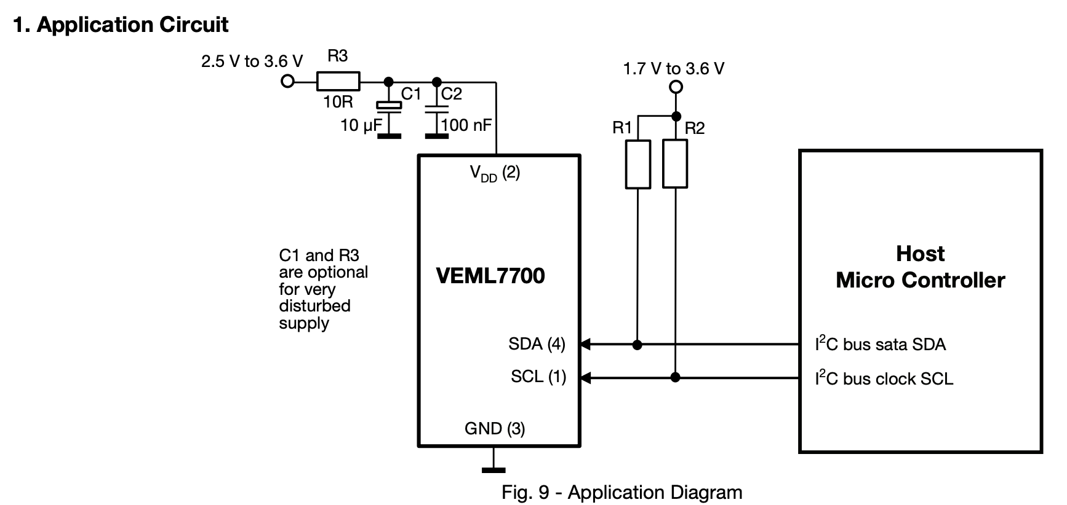
Datasheets used for circuit design
VEML7700

Slide 6
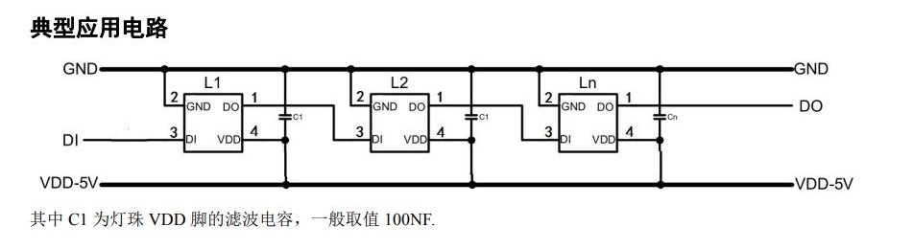
Datasheets used for circuit design
LED WS2812C

Slide 7
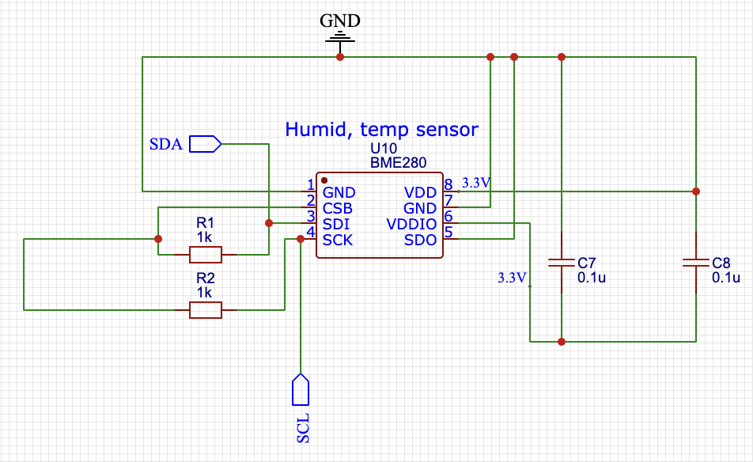
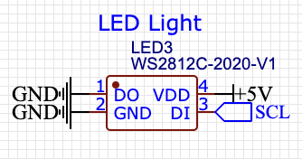
Circuit Design
Humidity, temperature sensor BME280
LED WS2812C

Slide 8
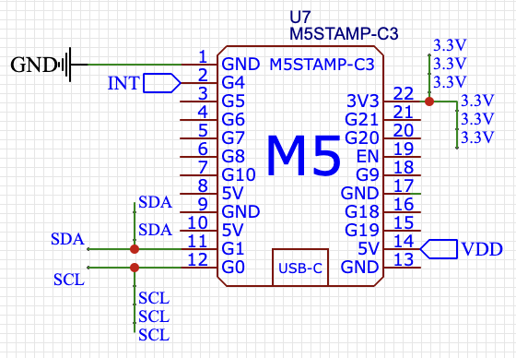
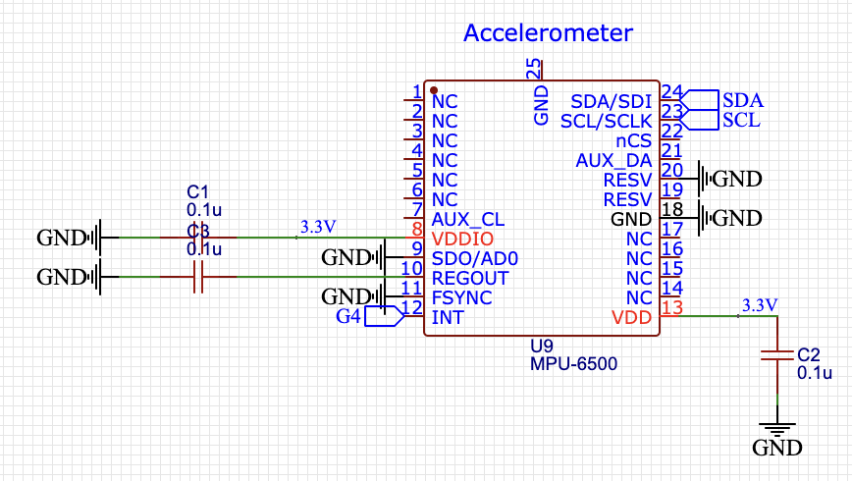
Circuit Design
M5 Stamp
Accelerometer / Gyroscope MPU-6500

Slide 9
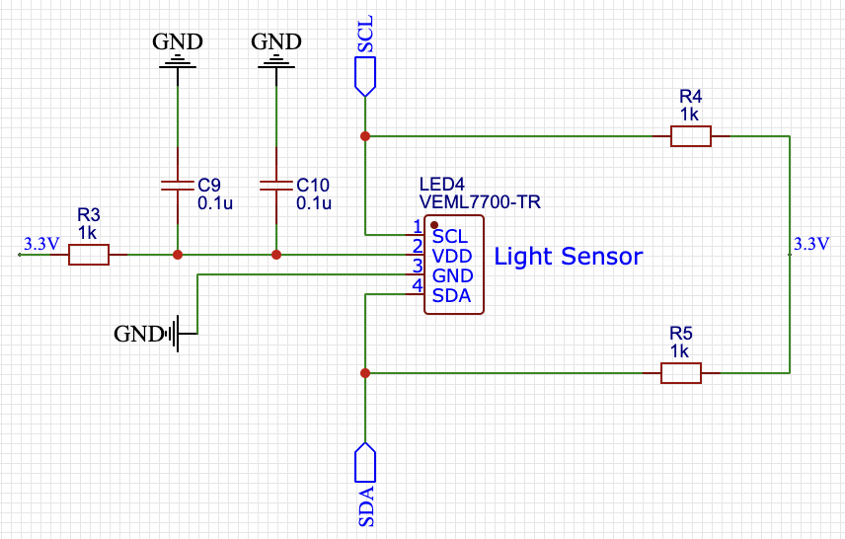
Initial Circuit Design
Light sensor VEML7700

Slide 10
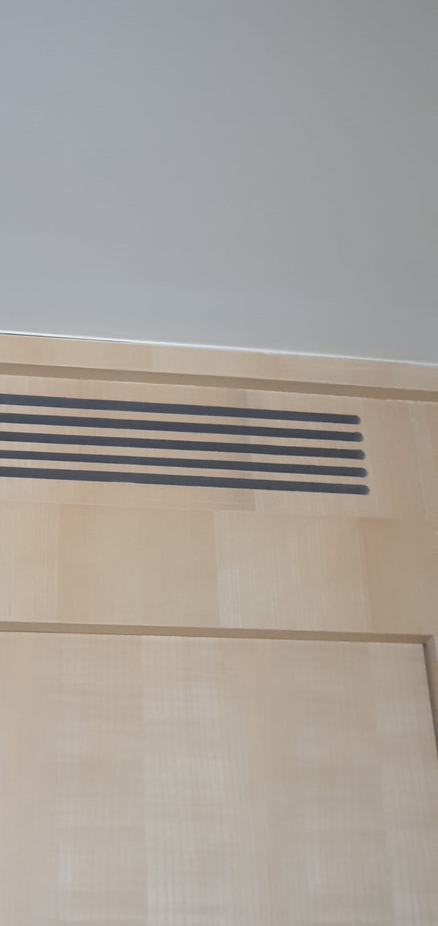
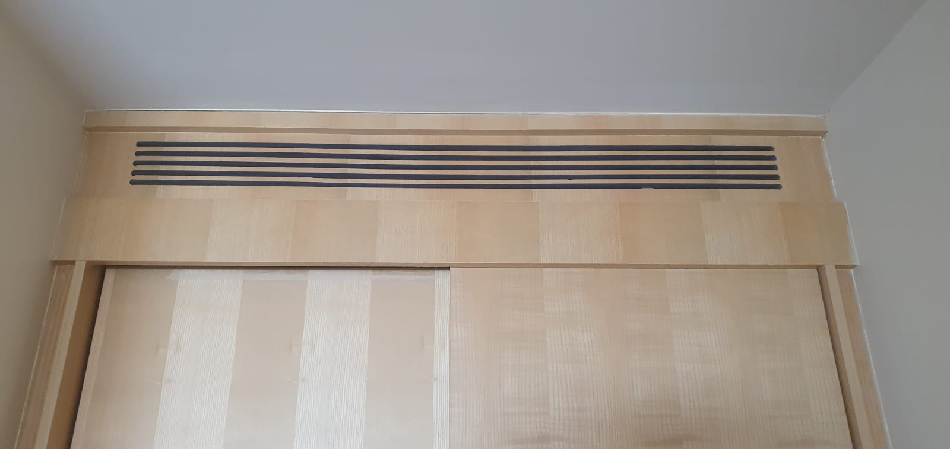
Device placement

Slide 11
Work to be done
Set ‘reasonable range’ of humidity and temperature (conditions for LED light to turn red/green)
Detect when temperature decreases (& plateaus) - record time duration of AC
Process raw data of temperature → Power used → Price
Connect to website to log data
User access to this data

Slide 12

We are looking forward to your feedback!

